Slide 1
Editing an assertion in Badger

Slide 2
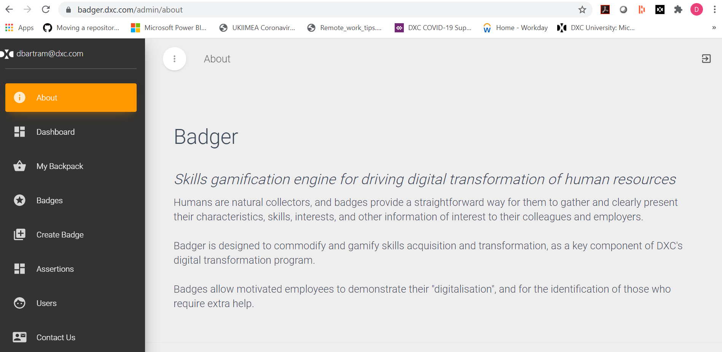
1. Visit badger.dxc.com , log in if necessary

Slide 3
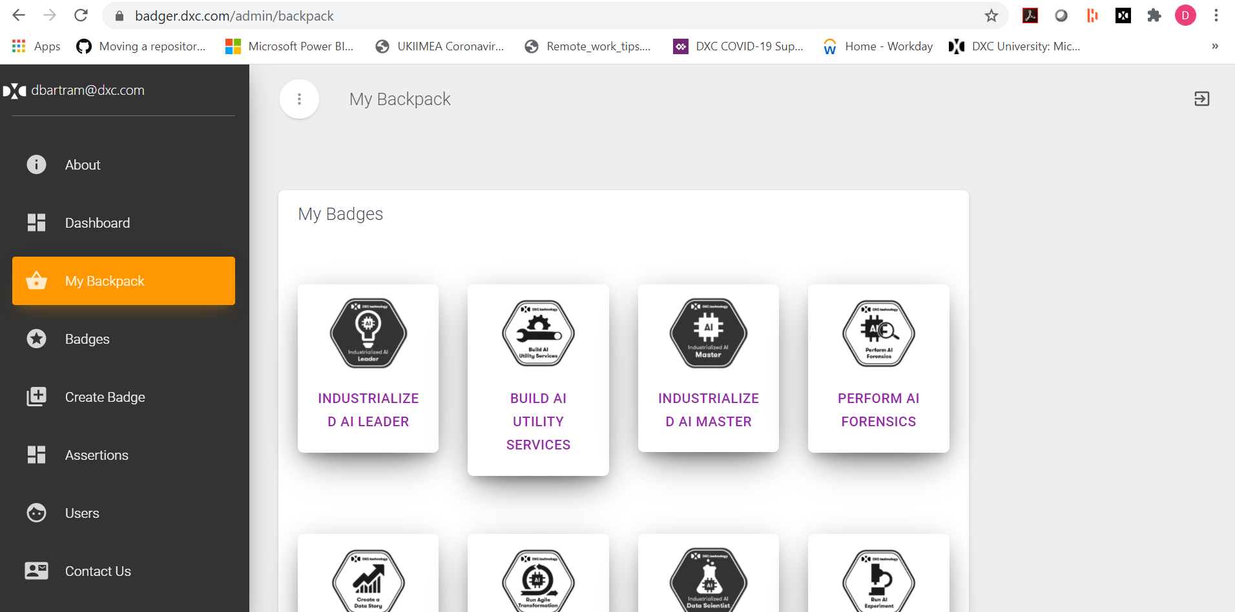
2. Click My Backpack on left menu, then click a badge

Slide 4
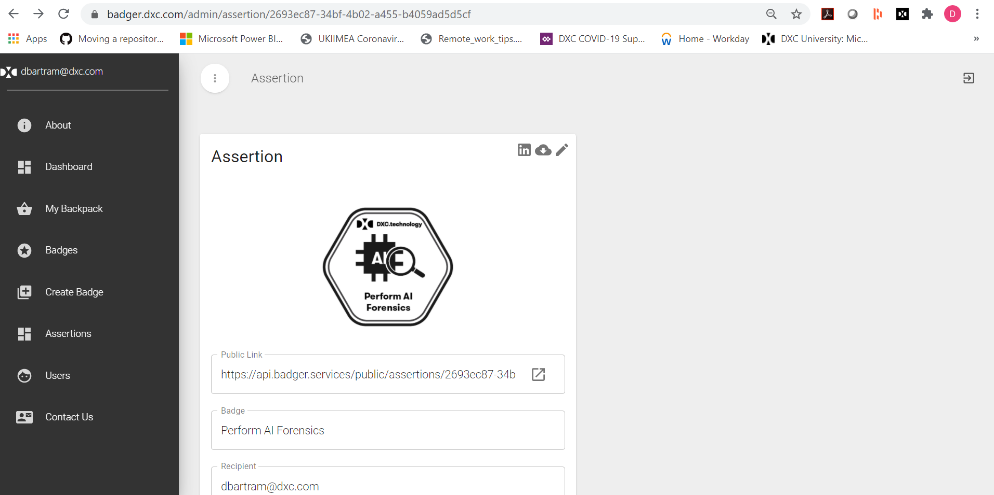
3. Click the pencil icon in the top right of the assertion

Slide 5
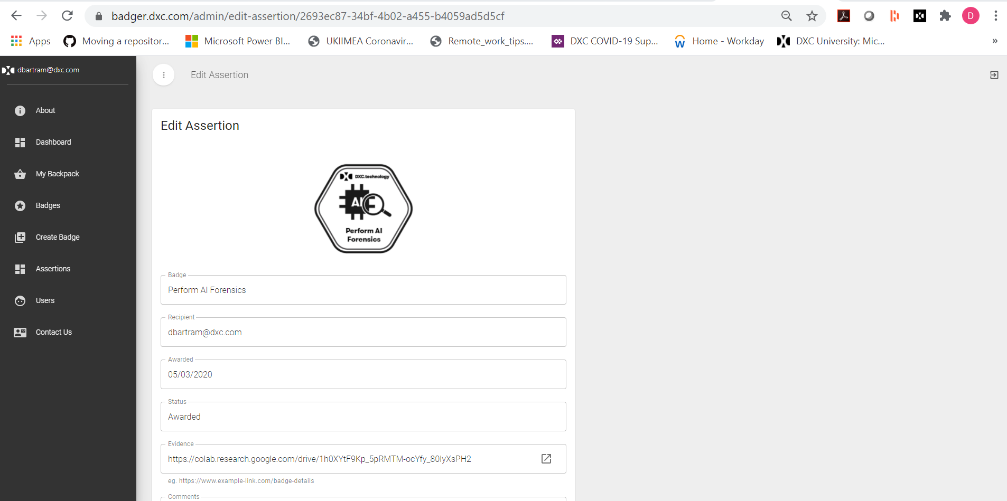
4. From the Edit Assertion page you should be able to make changes to the assertion if necessary. You can resubmit the badge if it is in currently in the Rework state.

